Slide 1


Buffet Decoration Ordering System
Presenters:
Abrar Fauzi
Razi Dallasheh
Supervisor:
Zeev Brazily

Slide 2


Introduction
The visual aesthetics play a pivotal role in creating memorable experiences.
The Buffet Decoration Project presents an innovative solution .

Slide 3
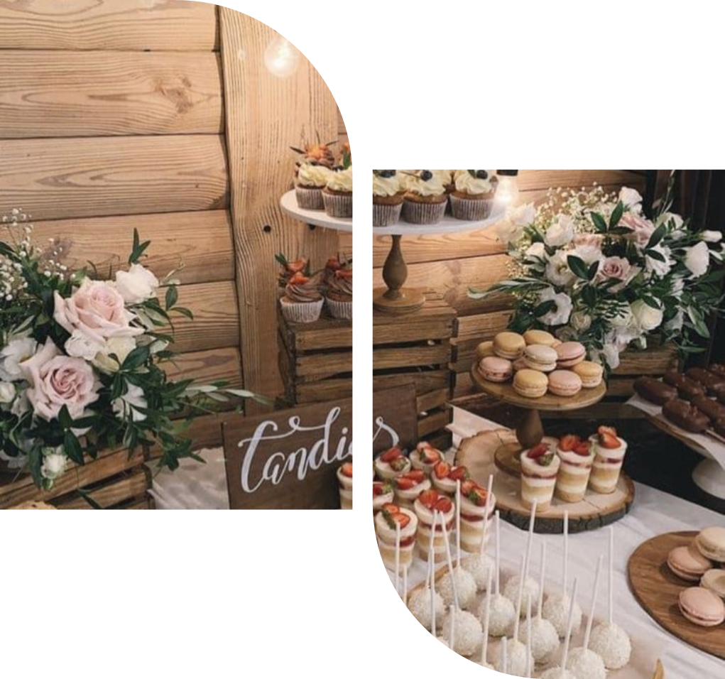
What is the problem?
Cumbersome and time-consuming process of arranging buffet decorations
manual coordination
Choosing the appropriate decoration
Lack of visualization of the last result.

Slide 4
Proposed Solution
introducing an innovative Buffet Decorations Ordering System
integrating a user-friendly interface, visual representation tools, and a comprehensive range of options.

Slide 5
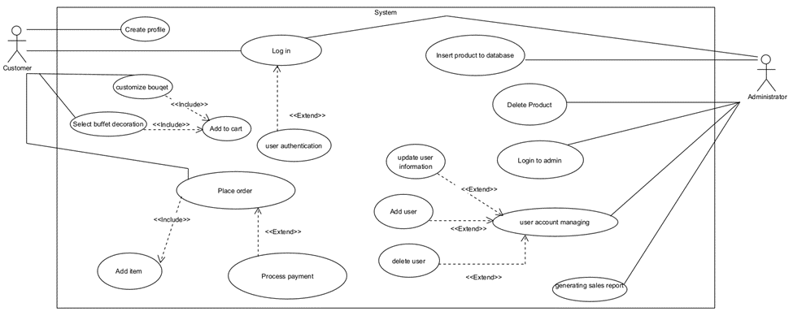
Use Case

Slide 6
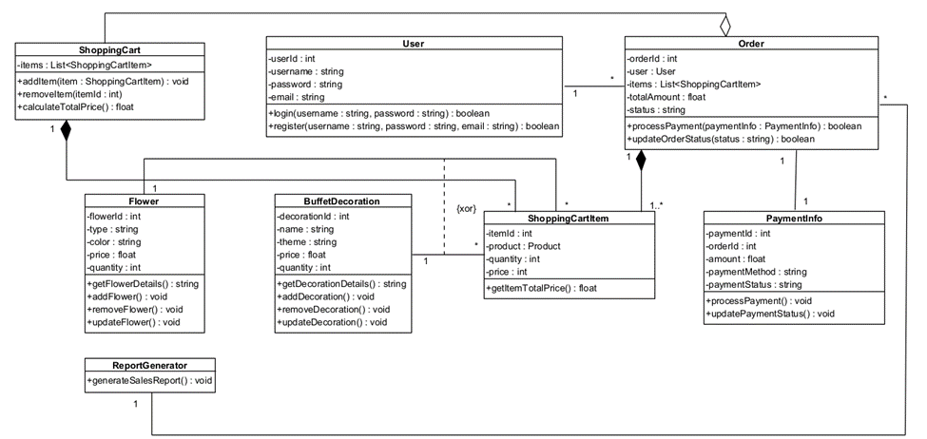
Class Diagram

Slide 7


User Interface
Overall Theme and Layout:
Clean ,modern,and intuitive.
facilitating a seamless and enjoyable experience.
soft color palette .

Slide 8
User Interface
Navigation Bar:
At the top of the page.
Allows easy access to different sections.
Ensures that user can quickly navigate between different options.

Slide 9
User Interface
Customization Panels:
interactive customization panel.
Divided into multiple sections including:
Flower Types:
Allows Users selecting their favorites based on the event theme.
Colors:
Allows users to choose the color theme.

Slide 10
User Interface
Buffet Decoration Customization:
Adjacent to the flower customization options, there is a section dedicated to buffet decorations. Here, users can select themes and explore decoration items that enhance the aesthetic appeal of their event's dining setup.

Slide 11
User Interface
Shopping Cart and Checkout Process:
The shopping cart is easily accessible via a sidebar that provides a summary of selected items, with options to edit quantities or remove items. The checkout button leads users to a secure payment process where they can enter their payment information and finalize their order with confidence.

Slide 12
User Interface
Interactive Elements:
Throughout the UI, interactive elements like dropdown menus, sliders for quantity, and toggle switches for different decoration options make the customization process engaging and user-friendly. Tooltips and help icons offer additional information and guidance, ensuring users feel supported throughout their design process.

Slide 13


What do we plan to do and why will it help solve the problem?

Slide 14




propose the development of an intuitive and interactive online platform that facilitates the entire process
choosing flower types, colors, and arrangements to selecting buffet decorations that complement the chosen theme
provide a visual preview of their selections, and offer a diverse range of options for customization
The solution simplifies the ordering process and enhances the overall event planning experience.

Slide 15
Testing
Functionality Testing
Performance Testing
Security Testing

Slide 16
Testing Method
Automated and Manual Testing
Load
Testing
Beta
Testing

Slide 17
Expected Challenges
•User Diversity: Designing an interface that caters effectively to users with varying degrees of technological proficiency.
•Load Management: Maintaining performance during peak usage, especially during major event seasons.
•Security: Protecting against data breaches, especially given the financial transactions involved.

Slide 18
Expected Results
•High Reliability and User Satisfaction: Expecting positive feedback on user interface design and overall functionality.
•Scalability Confirmation: The platform should handle increased loads without significant performance degradation.
•Security Robustness: No critical security vulnerabilities should be found.

Slide 19
Thanks For Listening

